Slide 1
Změny v partnerském programu
NextWave Palo Alto Networks
Kristína Kyšová
Business Development Manager
16.05.2023

Slide 2
Partnerské úrovně

Slide 4
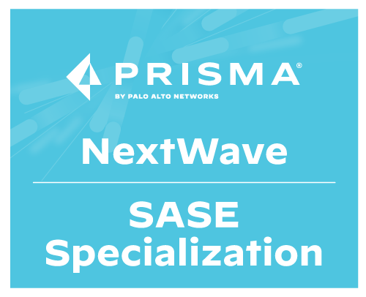
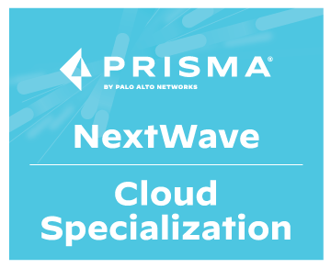
NextWave Program Framework
Portfolio Knowledge
Product Expertise

Slide 5
Podmínky platné od 1.8.2023

Slide 7
NextWave Product Specializations | Requirements
NEW
 | Hardware Firewall | Software Firewall | Prisma SASE | Prisma Cloud | Cortex XDR | Cortex XSOAR
Capabilities
Sales # of Sales Resources w/Certification | 2 Sales Product Specialist - Hardware Firewall | 3 Sales Product Specialist - Software Firewall | 3 Sales Product Specialist - SASE | 3 Sales Product Specialist - Cloud | 3 Sales Product Specialist - XDR | 3 Sales Product Specialist - XSOAR
Technical Pre-Sales # of Engineers w/Certification | 1 Palo Alto Networks Systems Engineer (PSE): Strata Professional | 2 Palo Alto Networks Systems Engineer (PSE): Software Firewall Professional | 2 Palo Alto Networks Systems Engineer (PSE): SASE Professional | 2 Palo Alto Networks Systems Engineer (PSE): Prisma Cloud Professional | 2 Palo Alto Networks Systems Engineer (PSE): Cortex Professional | 2 Palo Alto Networks Systems Engineer (PSE): Cortex Professional
Technical Post-Sales # of Engineers w/Certification | 1 (PCNSE or PCNSC) | 1 (PCNSE or PCNSC) and 1 (PMcNA, PMvNA or PMkNA) | 2 (PMRuA or PMRnA) | 2 PCCSE | 2 (PCDRA, PMXdS or PMXdC 1) | 2 ( PCSAEor PMXrC 1)
Engagement
Customer Activity | 20 Engagement Points | 20 Engagement Points² | 20 Engagement Points² | 20 Engagement Points² | 20 Engagement Points² | 20 Engagement Points²
Note: Engagement points are earned annually and reset to zero each fiscal year. For details on eligible activities, see the Product Specializations Engagement Points Guide.
¹Micro-credential is for CPSP partners and requires attending an invitation-only CPSP training workshop. | ²Minimum of 2 customer evals via the Partner Evaluation System (PES) required per fiscal year to maintain specialization. Partners seeking to gain specialization are exempt of evals requirement but still require minimum of 20 engagement points.
Notes:
Partners have the ability to earn specialization in the PANW technology(ies) most important to their business, with an offering across the entire PANW portfolio.
Product Specializations include capabilities (certified sales, pre-sales and post-sales resources) and engagement (customer activity) requirements in the specific PANW technology.
Professional-level certifications (vs Associate) are now required to satisfy technical pre-sales and post-sales capabilities requirements. This change has been made to meet the needs of today’s market and customer demands.
Customer activity is linked to the tools we provide NextWave partners, and tool usage is measured in engagement points. A minimum of 20 engagement points are required per Product Specialization.

Slide 8
Engagement poins
Partner Eval System (PES) = 2 points per Eval
Best Practice Assessment (BPA) = 2 points per BPA
Security Lifecycle Review (SLR) = 2 points per SLR
5 Minute Fix = 1 point per 5 Minute Fix
Capture the Flag (CTF) = 2 points per CTF
Ultimate Test Drive (UTD) = 2 points per UTD
Not-for-Resale (NFR) = 1 point per NFR device / license
Product Specializations Engagement Points Guide [Updated: 4.5.2023] (paloaltonetworks.com)

Slide 9
Obchodní výhody
Hardware Firewall | Software Firewall | Prisma SASE | Prisma Cloud | Cortex XDR | Cortex XSOAR
+5% on PA-Series line item Deal Reg Op + Standard Discount & Deal Reg Incentive @ Standard Price | +5% on VM-Series & CN-Series line item Deal Reg Op + Standard Discount & Deal Reg Incentive @ Standard Price | +5% on SASE line item Deal Reg Op + Standard Discount & Deal Reg Incentive @ Standard Price | +5% on Prisma Cloud line item Deal Reg Op + Standard Discount & Deal Reg Incentive @ Standard Price | +5% on Cortex XDR line item Deal Reg Op + Standard Discount & Deal Reg Incentive @ Standard Price | +5% on Cortex XSOAR line item Deal Reg Op + Standard Discount & Deal Reg Incentive @ Standard Price

Slide 10
Jsme Vašim Partnerem 15+ let zkušeností v oblasti kybernetické bezpečnosti – 8 členný tým
Produktová školení | Technická školení | Pre sale podpora | Technická podpora | Obchodní podpora | Marketingová podpora
1x měsíčně vybrané téma Za obchodní certifikaci sladká odměna | 1/Q partnerský seminář Příprava na PCNSA a PCNSE Certifikovaná školení Palo Alto Networks Autorizované certifikační centrum | UTD, PSE, BPA, SLR, CTF, Aktivní realizace spolu s vámi Návody jak na to | Lokální v českém jazyce Implementace s vámi | Prezentace řešení u vašeho zákazníka Příprava podkladů k řešení Cenové podklady | Realizace marketingových aktivit s vámi Aktivní účast a prezentace pro vaše zákazníky Finanční spoluúčast

Slide 11
Děkuji za pozornost
+420 602 142 515
Kristína Kyšová
Business Development Manager
kristina.kysova@tdsynnex.com
paloaltonetworks_cz@tdsynnex.com

