Slide 1
Prisma Cloud
Code Security
Petr Zahálka
TD SYNNEX AS CZECH
Notes:
Thank you for joining today’s presentation. I’m excited to provide you with an overview of Prisma Cloud’s Cloud Code Security capabilities, par of the industry’s most comprehensive Cloud Native Application Protection Platform, that delivers code security across the full application lifecycle.

Slide 2
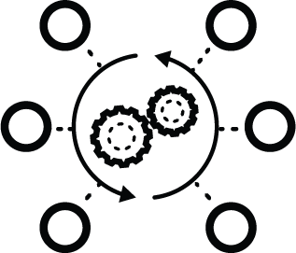
Challenges Faced by Organizations Today
Developers aren’t
security experts
Developers are not security experts and cannot be expected to know all security and compliance requirements especially as new vulnerabilities are identified and
Current approaches lack essential context
Developers are innovating at rapid rates and reactive security feedback forces context switching that slows down release cycles, not to mention leaves risks unmitigated for far too long
No connection between build-time and runtime
Inconsistencies from build policies to runtime policies and gaps in vulnerabilities across the development lifecycle create confusion and frustration for security and developer teams
Notes:
More friction is introduced when you consider that developers are not security experts and cannot be expected to know all of the security and compliance requirements. When security feedback is provided, it is typically after developers have moved to their next project and without actionable guidance. Finally, the feedback developers get is often disjointed from their own linters to their runtime security.

Slide 3
Modern Cloud-Native Code Risks
Terraform
modules
Open source packages
Container images
64%
81%
91%
of downloads result in at least one high or critical insecure configuration
of apps contained vulnerabilities
of images contain at least one critical or high severity vulnerability
SOURCE: Palo Alto Networks Unit 42
Notes:
Furthermore, you can’t implicitly trust the code that developers create or that are in public registries. Open source templates and images drastically speed up the pace of development, but they are not without their flaws.
Our Unit 42 research team scanned popular open source registries, including Terraform, Artifact Hub, and Docker Hub and found that 64% of Terraform Modules had at least one high or critical misconfiguration, 99% of Helm charts contained at least one misconfiguration and 91% of container images had at least one critical or high severity vulnerability.

Slide 4
Prisma Cloud
Integrated capabilities for complete cloud native application protection
Cloud Code Security
Secure app artifacts, analyze code, and fix issues
Cloud Security Posture Management
Monitor cloud security posture, detect and respond to threats, maintain compliance
Cloud Workload Protection
Secure hosts, containers, and serverless across the application cycle
Cloud Network Security
Monitor and secure cloud networks, enforce microsegmentation
Cloud Identity Security Enforce permissions and secure identities across workloads and clouds
Infrastructure as Code (IaC) Security
Visibility, Compliance & Governance
Host Security
Identity-Based Microsegmentation
Cloud Infrastructure Entitlement Management
Software Composition Analysis (SCA)
Threat Detection
Container Security
Software Supply Chain Security
Data Security
Serverless Security
Web App & API Security
Notes:
(Only show to Prisma Customers)
DevSecOps is the newest pillar of the Prisma Cloud’s Cloud Native Security Platform
Recognition that a core piece of a complete cloud security solution is DevSecOps.

Slide 5
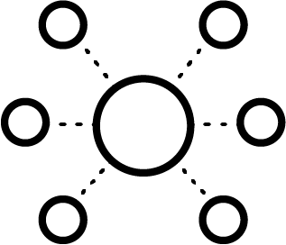
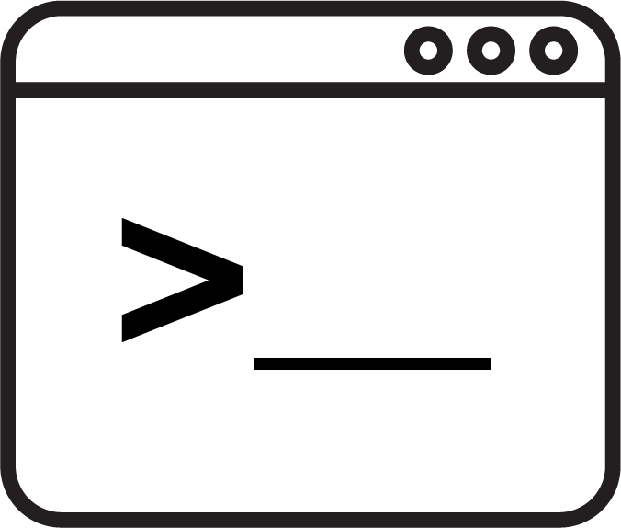
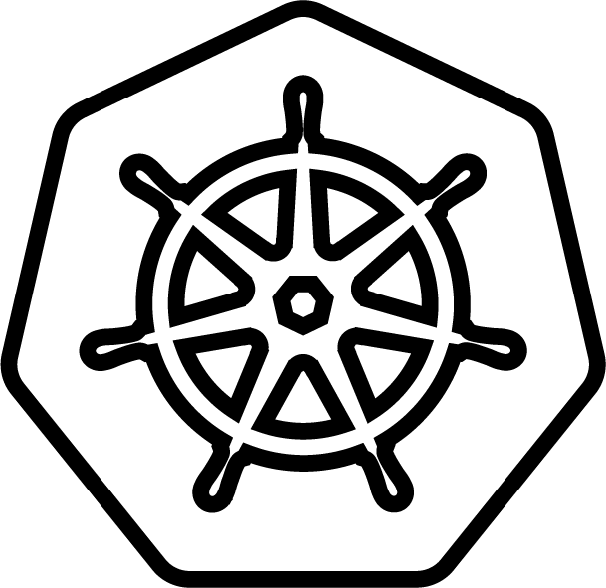
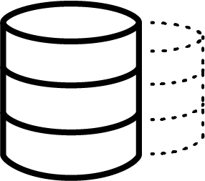
Securing Cloud Native Application Code is Complex
Dependent on multiple packages
Dependent on multiple manifests and images
Build
template
Dependencies
Custom
code
Opportunity for vulnerabilities and misconfigs
Provisioned by multiple
IaC templates
Kubernetes
Opportunity for misconfigurations
Compute
Storage
Networking
Opportunity for misconfigurations
Cloud infrastructure
Container orchestration
Containers
Notes:
The problem starts with the level of complexity for cloud native applications. At each level of the stack, there is an opportunity to introduce a misconfiguration or vulnerability, exposing your organization to a breach. This is even more difficult to discern in code than in runtime environments.

Slide 6
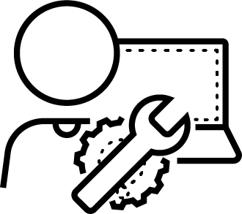
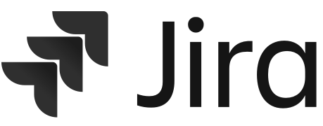
The Next Big Challenge: “Shift Left” Cloud Security
1
Misconfigured or vulnerable repo
100s
of deployments
1,000s
of security alerts
Turns Into
Turns Into
Build
Deploy
Run-Time
Developers
DevOps
Security
Issues To Fix
1x
Cost to fix a bug found during coding
5x
Cost to fix a bug
found during testing
20x
Cost to fix a bug
found in production
Uncaught
Uncaught
Notes:
This issue is compounded when you look at how those resources are deployed. A single template can have multiple misconfigs and vulnerabilities, and that can deploy dozens of resources. Multiple that together and you get thousands of alerts at runtime. All of those alerts turn into Jira tickets for developers to handle weeks after they developed the code and without context.

Slide 7
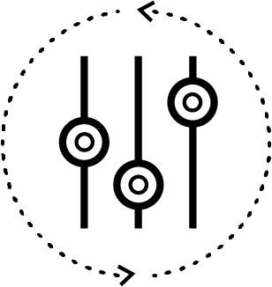
Secure Cloud-Native Development Requires a New Approach
Embedded
policy-as-code
Dev-centric IaC security leveraging code based policies embedded in DevOps tools
Proactive feedback and enforcement
Automated security feedback throughout the SDLC with inline code fixes and guardrails
Comprehensive
coverage
Continuous compliance and security for popular frameworks & clouds
Notes:
The solution is to provide a developer-friendly, policy-as-code engine. Through automation, developers receive actionable feedback in context. This has to be for their full stack and evolve with applications as they change frameworks.

Slide 8
Secure Development with DevSecOps
1
Secure
repos
100s
of deployed secure workloads
Minimal
security alerts post-deployment
Build
Deploy
Run-Time
Developers
DevOps
Security
Increased
developer productivity
Decreased
Cost to fix a bug found during coding vs in production
Notes:
The result is secure repositories, leading to secure workloads and minimal security alerts. Without the negative feedback loop, security teams and developers are more productive and can work on higher level problems.

Slide 9
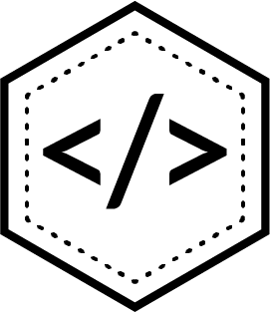
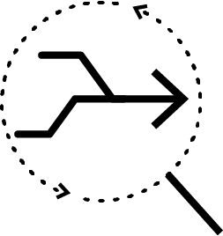
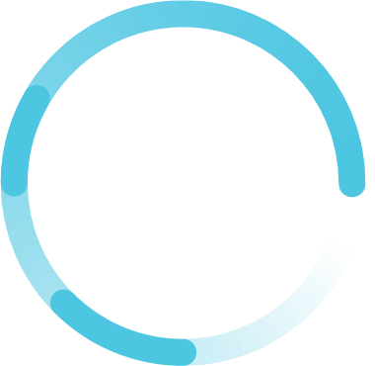
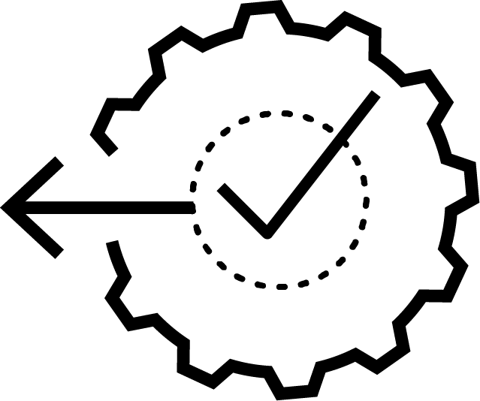
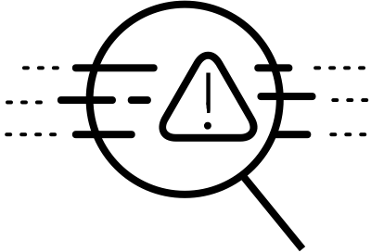
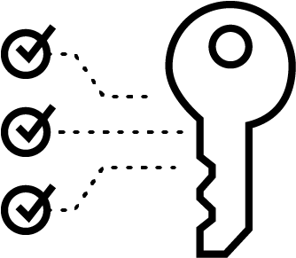
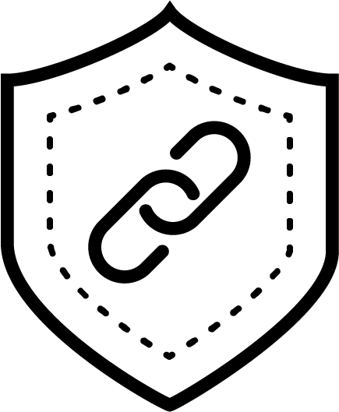
Infrastructure as code (IaC) security
Identify and fix security misconfigurations in your IaC templates in development and in pipelines
Software composition analysis (SCA)
Identify vulnerabilities in library dependencies across popular languages
Drift detection
Automate finding and fixing drift between code and cloud to benefit from GitOps best practices
Secrets scanning
Prevent exposing passwords, API keys, and other secrets from ever making it into public repositories
Prisma Cloud
Code Security
Least privilege IAM
Reduce the attack surface with cloud IAM converted to code and audited for least privilege
Software Supply Chain Security
Inventory and visualize your code assets and their posture; remediate all issues with a single pull request
Notes:
Prisma Cloud offers comprehensive code security. We provide image scanning for hosts, containers and serverless code. We secure most of the popular infrastructure as code frameworks. We secure dependencies in repositories and highlight secrets to prevent exposure. We block overly permissive IAM credentials in code and generate secure IAM templates in Terraform. Finally, we provide a graph visualization of all infrastructure as code, container images, and dependencies along with their posture to provide a tool to discuss attack surface.

Slide 10
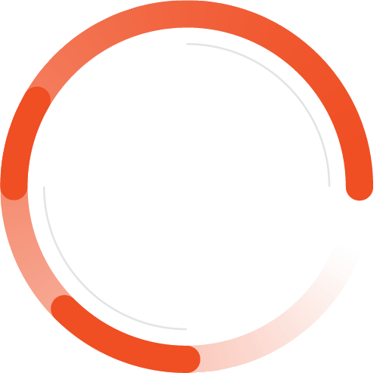
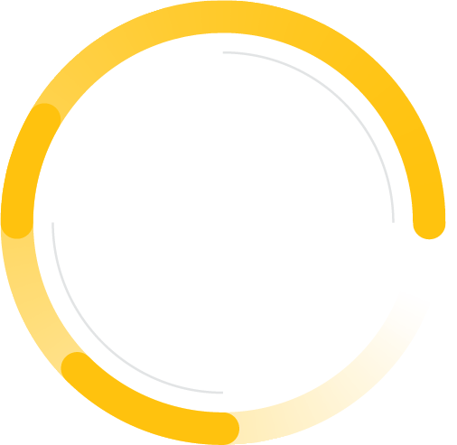
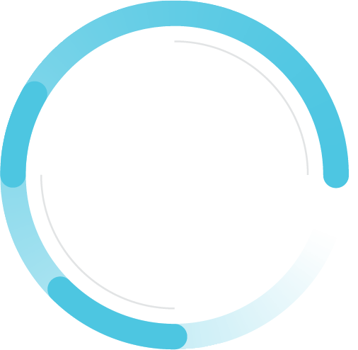
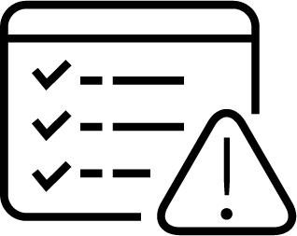
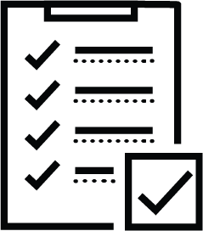
The Benefits of Code Security
Reduce alerts
Lower time to remediation
Simplify compliance
Minimize the attack surface
Notes:
We’ve seen a real evolution for companies who adopt DevSecOps with us. The number of alerts is reduced, remediation rates increase and the time to remediation decreases. Compliance audits are simplified and attack surfaces are minimized.

Slide 11
WHY PRISMA CLOUD
The top five reasons customers use Prisma Cloud Code Security
1.
Comprehensive coverage of tech stacks
2.
Integrated with developer tools
3.
Automated to remediate at scale
4.
Built on leading open source technology
5.
Recognized leader with proven results
Notes:
Customers choose us for five primary reasons.

Slide 12
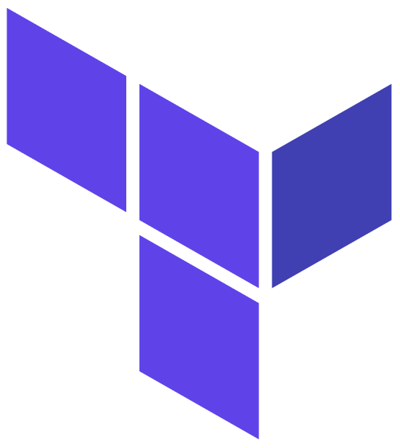
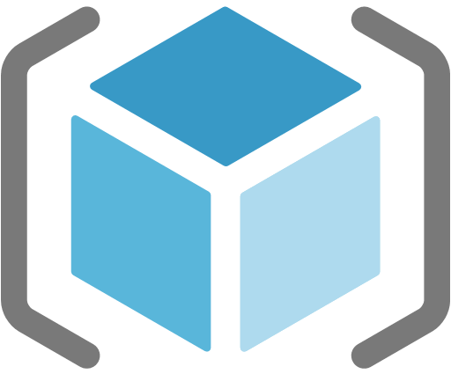
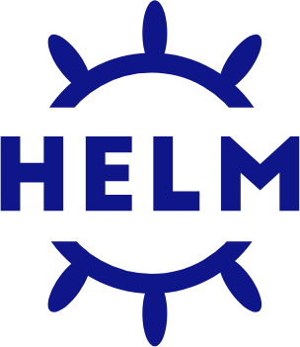
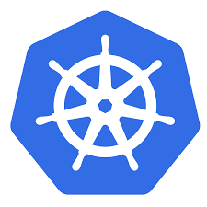
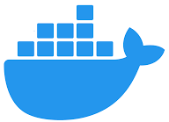
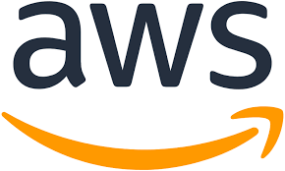
1 2 3 4 5
Comprehensive Coverage of Tech Stacks
Build-time
Runtime
Available information, representation of running resource
Complexity, time, risk of finding and fixing errors
Notes:
We have an industry leading coverage of infrastructure as code frameworks and package libraries. Today, we have over 500 policies for three cloud providers and Kubernetes, with more being added every week.

Slide 13
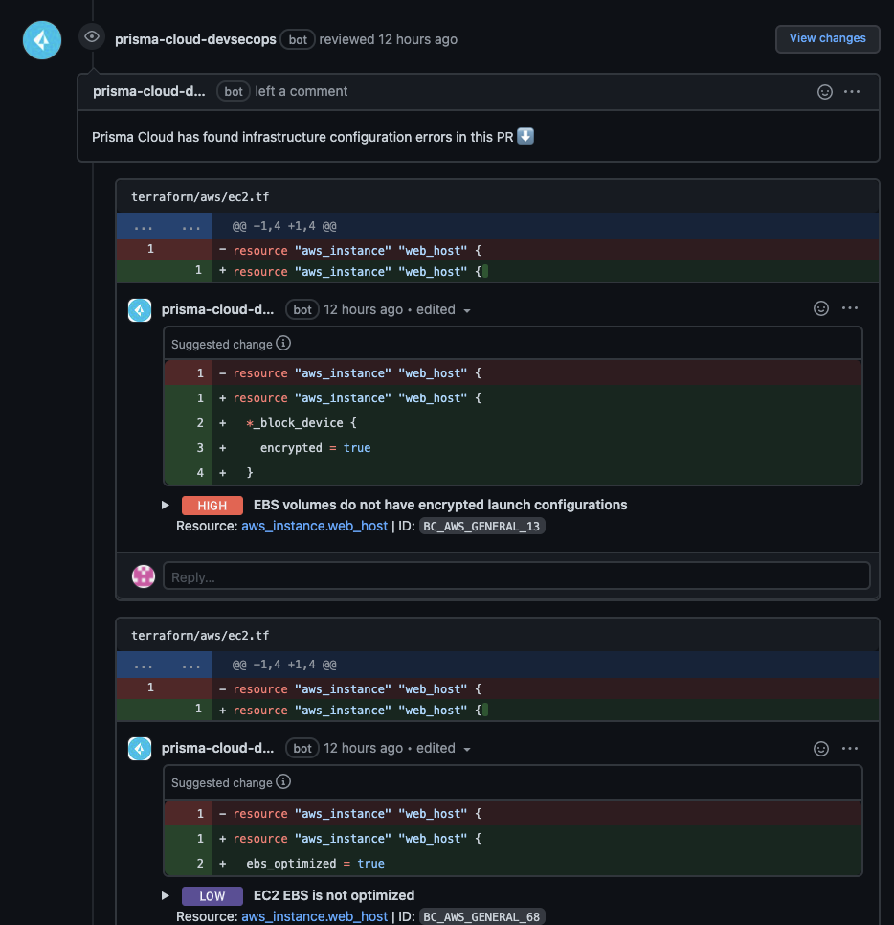
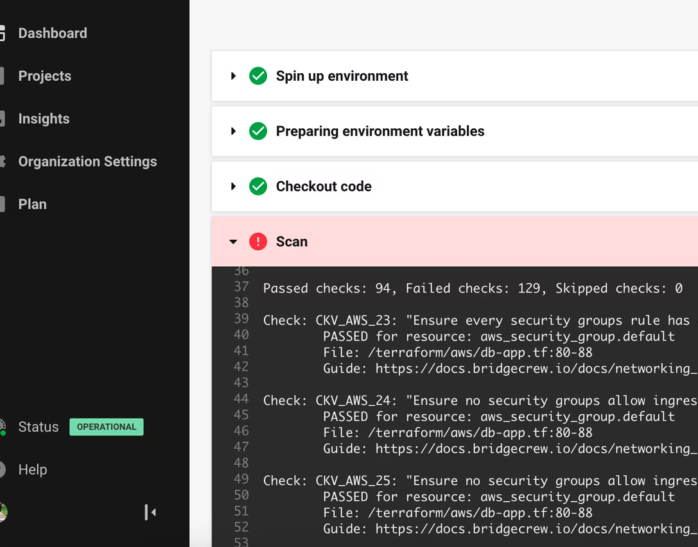
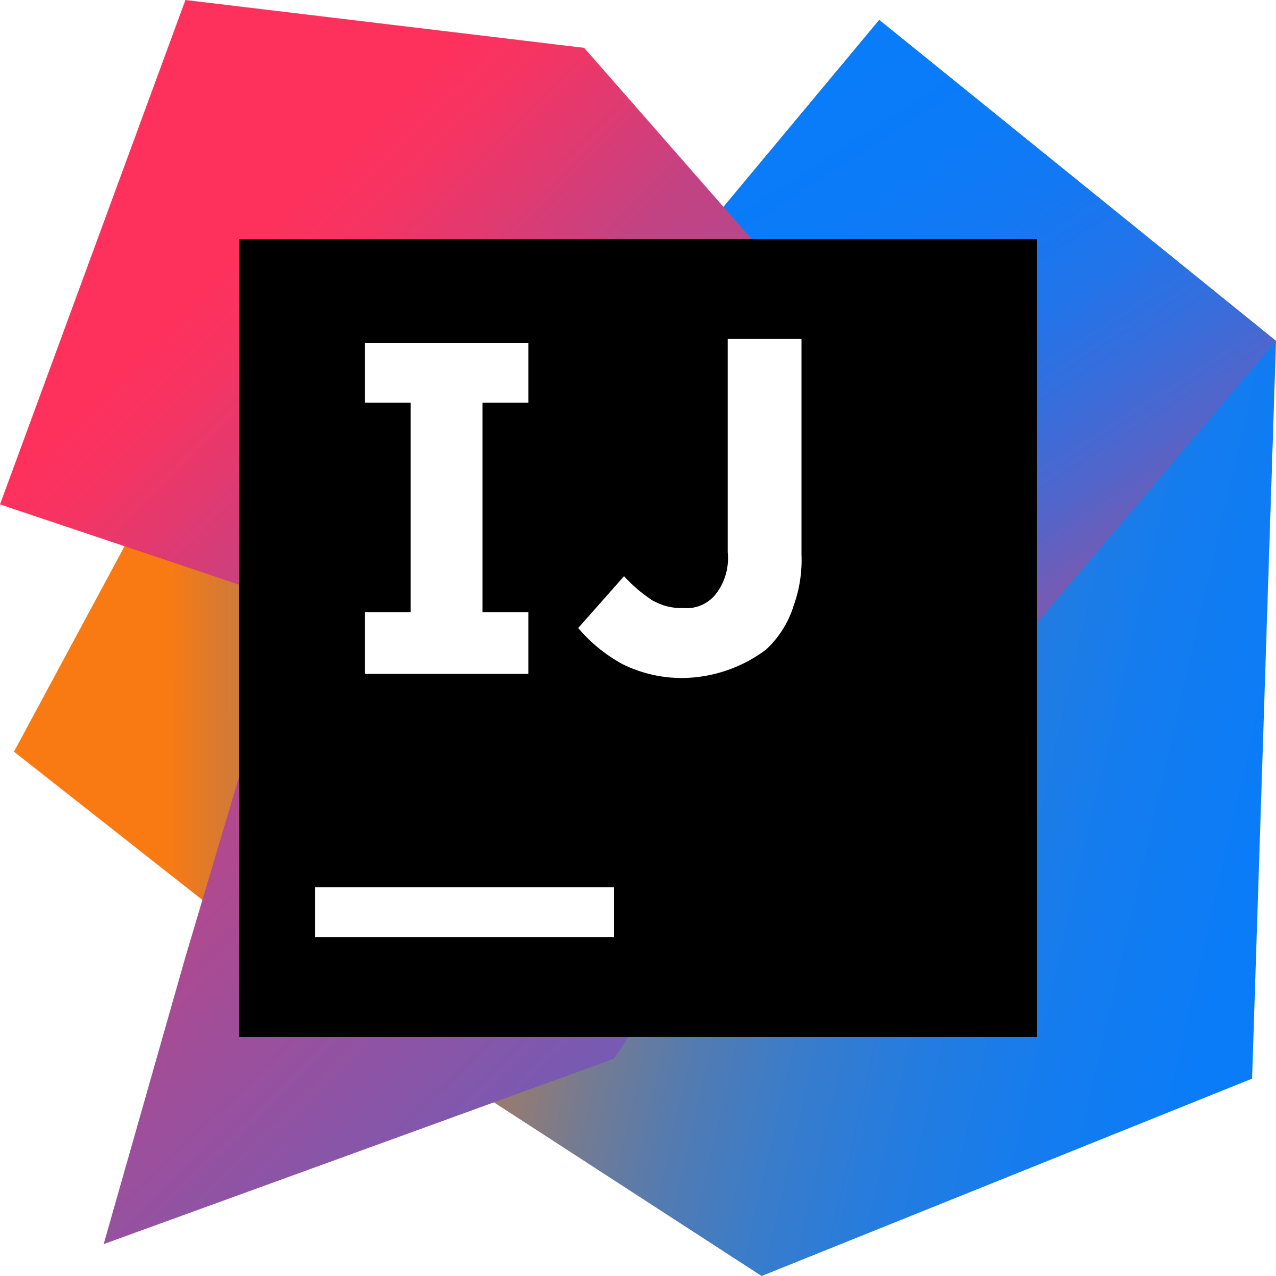
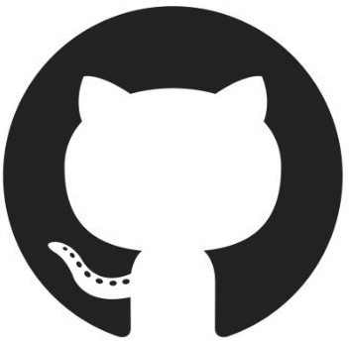
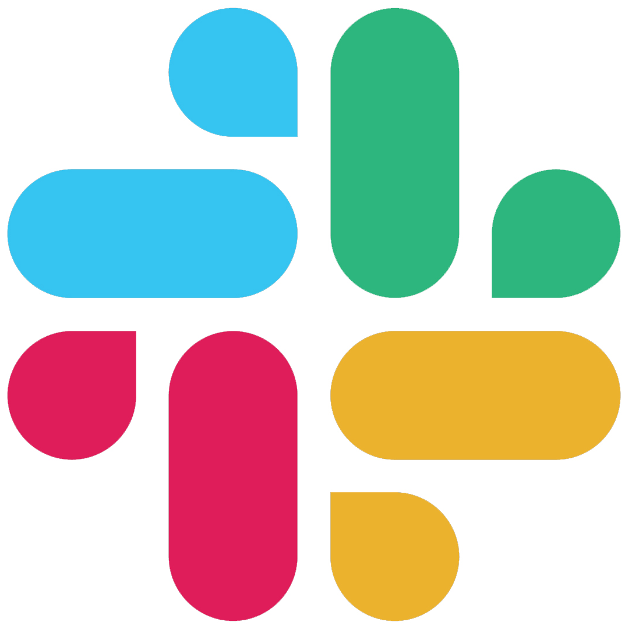
1 2 3 4 5
Integrated with Developer Tools
IDE
VCS
CI/CD
Ops
3 integration options
7 integration options
7+ integration options
3 integration options
Developer feedback and inline code fix suggestions to secure code as it’s typed
Automated PR comments with severity, commit ready fix suggestions to provide feedback in context
Automated guardrails to prevent insecure code turning into insecure infrastructure
Actionable, customizable alerting to resolve issues fast
Notes:
We integrate into most of the popular developer tools across the development lifecycle. These are not just basic integrations, they are designed to provide in-context feedback to developers that they will actually leverage.

Slide 14
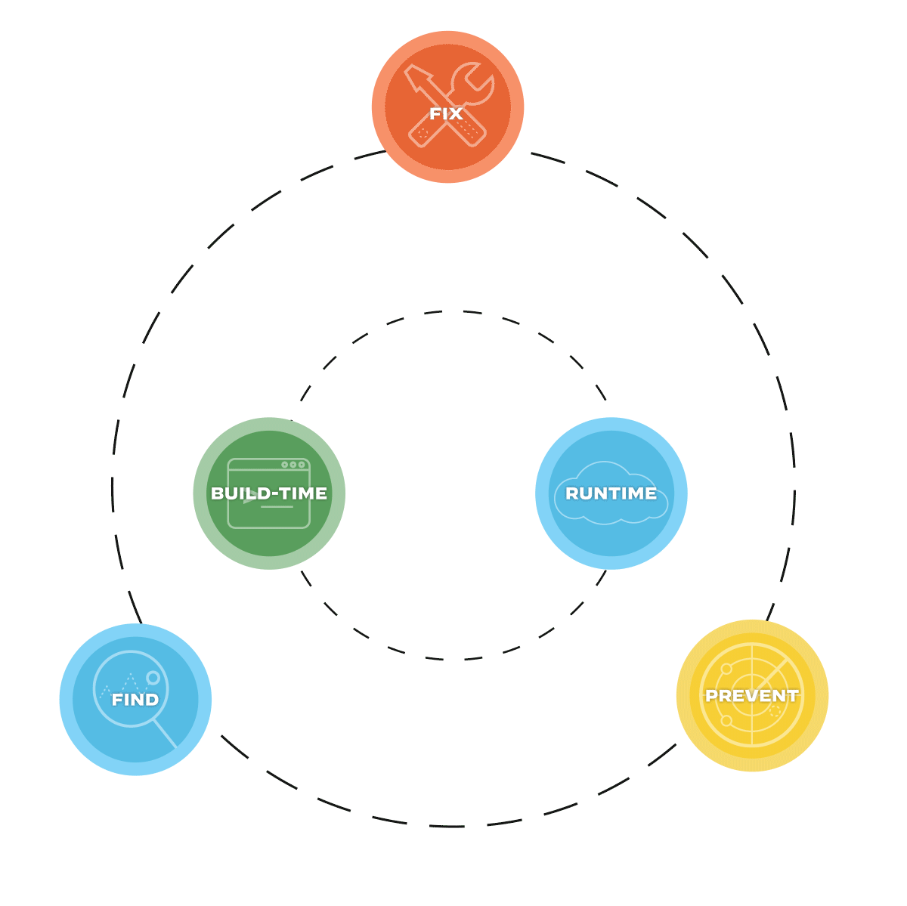
1 2 3 4 5
Automated to Remediate at Scale
Find and visualize vulnerabilities and misconfigs embedded in DevOps tools
Enforce policy-as-code guardrails with actionable feedback
Fix issues in code, with code with commit ready pull request fixes
Smart Fixes automatically generated from past secure coding behavior
Detect and remediate drift with pull request fixes
Notes:
We automate security at scale. We provide visibility into misconfigurations and vulnerabilities right to the developer and security teams. We add in actionable feedback with fix suggestions and Smart Fixes sourced from previous secure coding behavior. And we provide guardrails to block insecure code from being deployed.

Slide 15
1 2 3 4 5
Built on Leading Open Source Technology
4.2k
7.7M
Centralized supply chain view and drift detection
Capabilities Provided by the Platform
Simplified custom policy creation and management
Automated pull request comments for immediate actionable feedback
Fixes and Smart Fixes provided as code
Software Supply Chain visualization for code inventory and posture
Centralized view of all scans across integrations with drift detection
PR ready fixes and Smart Fixes
Increased Posture and Velocity
VCS PR Comments
Custom policy creation and suppressions
Automated CI/CD guardrail
Manual security reviews
Visibility into code posture
Expanded Capabilities
Notes:
We’ve build all of this on leading open source projects including Checkov, Yor and AirIAM. Checkov provides visibility into the posture of code and our platform takes that a step further by providing automated feedback as pull request comments and code based fix suggestions.

Slide 16
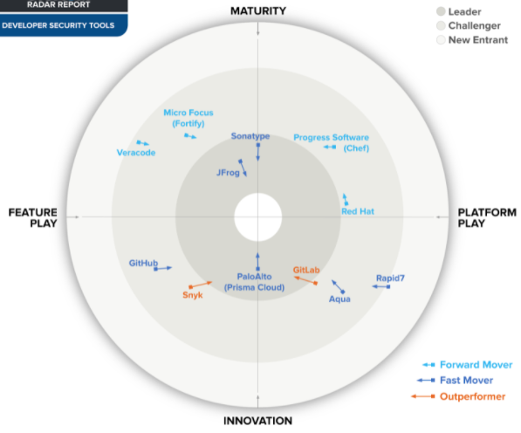
1 2 3 4 5
Recognized Leader with Proven Results
Improved Efficiency & Productivity
60%
80%
“
Strong IaC and cloud infrastructure scanning and policy enforcement, with an enticing “full security platform” approach, makes this solution an attractive one-stop shop
Reduction in
DevOps time addressing vulnerabilities
Reduction in
time spent configuring policies
”
SOURCE: Palo Alto Networks Prisma Cloud Total Economic Impact 2021, GigaOm Radar for Developer Security Tools
Notes:
Our results have been recognized by industry analysts. Forrester in their Total Economic Impact report found that we reduced the time addressing vulnerabilities by 60% and the time configuring policies by 80%. Furthermore, we were the only CNAPP recognized as a leader in the GigaOm Radar for Developer Security Tools.

Slide 17
Culture, People, Process
Devops:
Want to have nearly 100% of their cloud infra done using code.
Struggle with cloud security alerts and tickets.
Not security experts but open to checks and advice on their code.
Familiar with open source tools like Checkov
Security:
Overwhelmed by runtime alerts and chasing tickets.
Focus on visibility and education over guardrails. Don’t want to be seen as a blocker.
Have SecOps teams of their own
Policy as code for industry benchmarks.
Recognize CCS as a DevOps tool that benefits security

Slide 18
Capabilities

Slide 19
IaC Security
Find and fix misconfigurations in infrastructure as code templates
Comprehensive coverage of popular frameworks
Policy as code to create guardrails mapped back to industry frameworks and contributed checks
Automation Visibility Prevention

Slide 20
Software composition analysis (SCA)
Vulnerability management for dependencies in git repositories
Package bumping to simplify remediating vulnerabilities
Support for major languages and frameworks

Slide 21
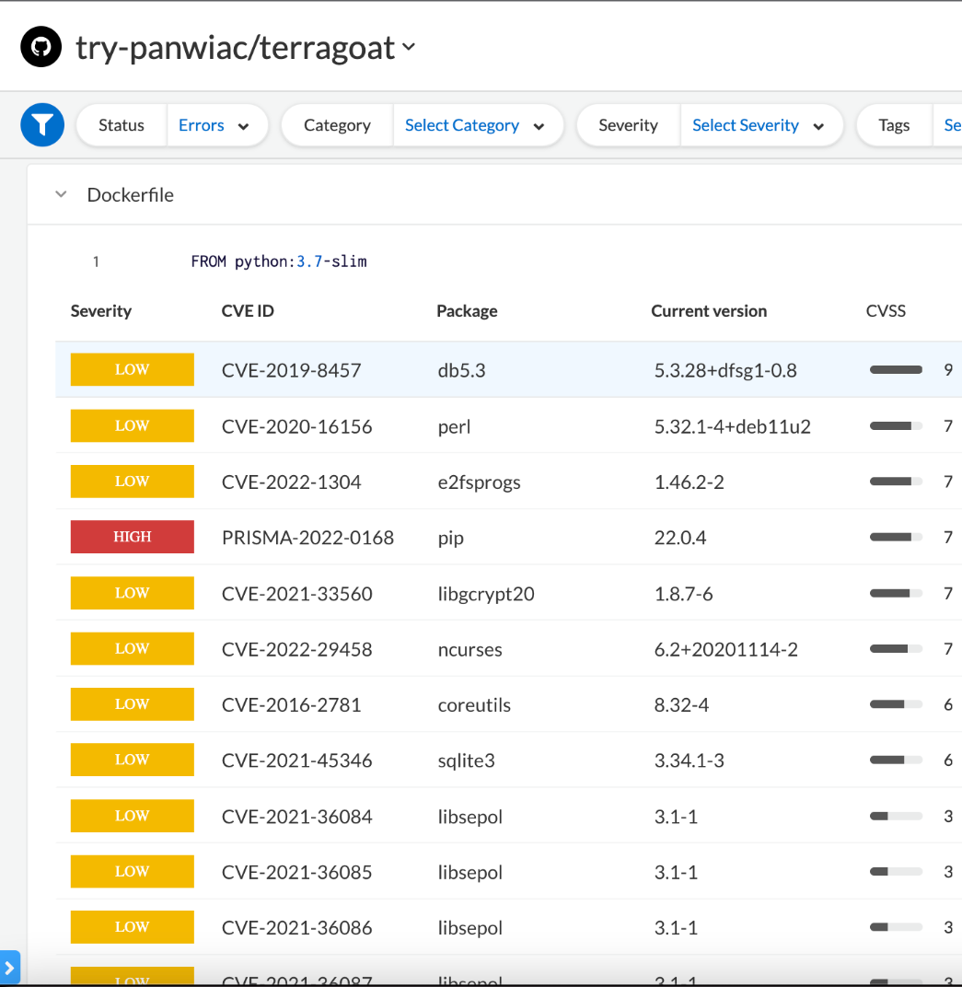
Container Image Scanning
Industry leading vulnerability management precision
Automated prioritization of vulnerabilities based on your unique environment
Prevent running vulnerable software across your environment

Slide 22
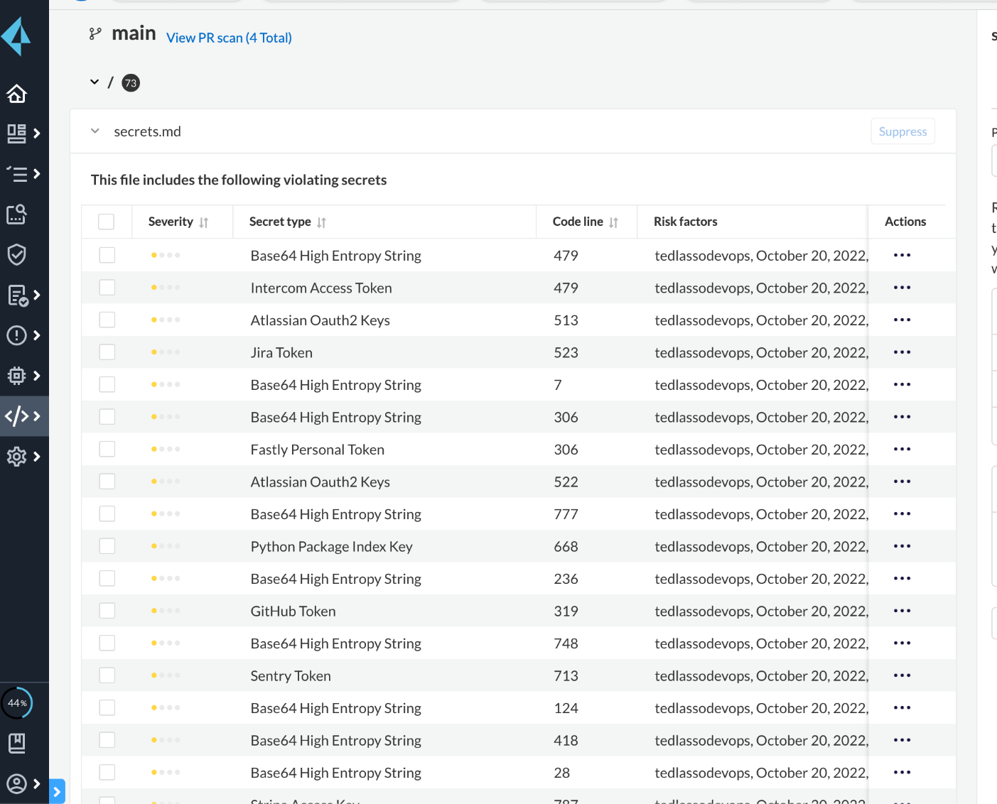
Secrets Security
Precise detection: Gain unmatched visibility via 2 analysis techniques that include a fine-tuned entropy model
Vast coverage: Detect common strings with over 100 signatures across any file type
Developer feedback: From supply chain impact to in-line pull request comments, embedded feedback streamlines developer action
Risk factors: Gain insights from multiple parameters for deep context with each alert
Customization: Define org-specific strings and reduce alerts

Slide 23
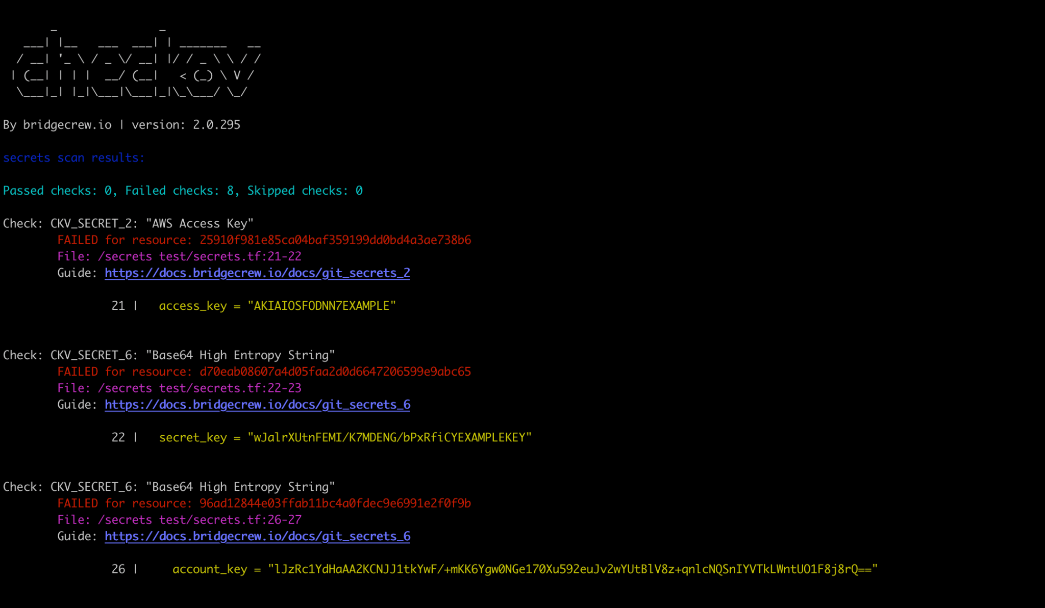
Secrets Scanning
Identify and block secrets in IaC templates and container images
Prevent secrets exposure and account takeovers

Slide 24
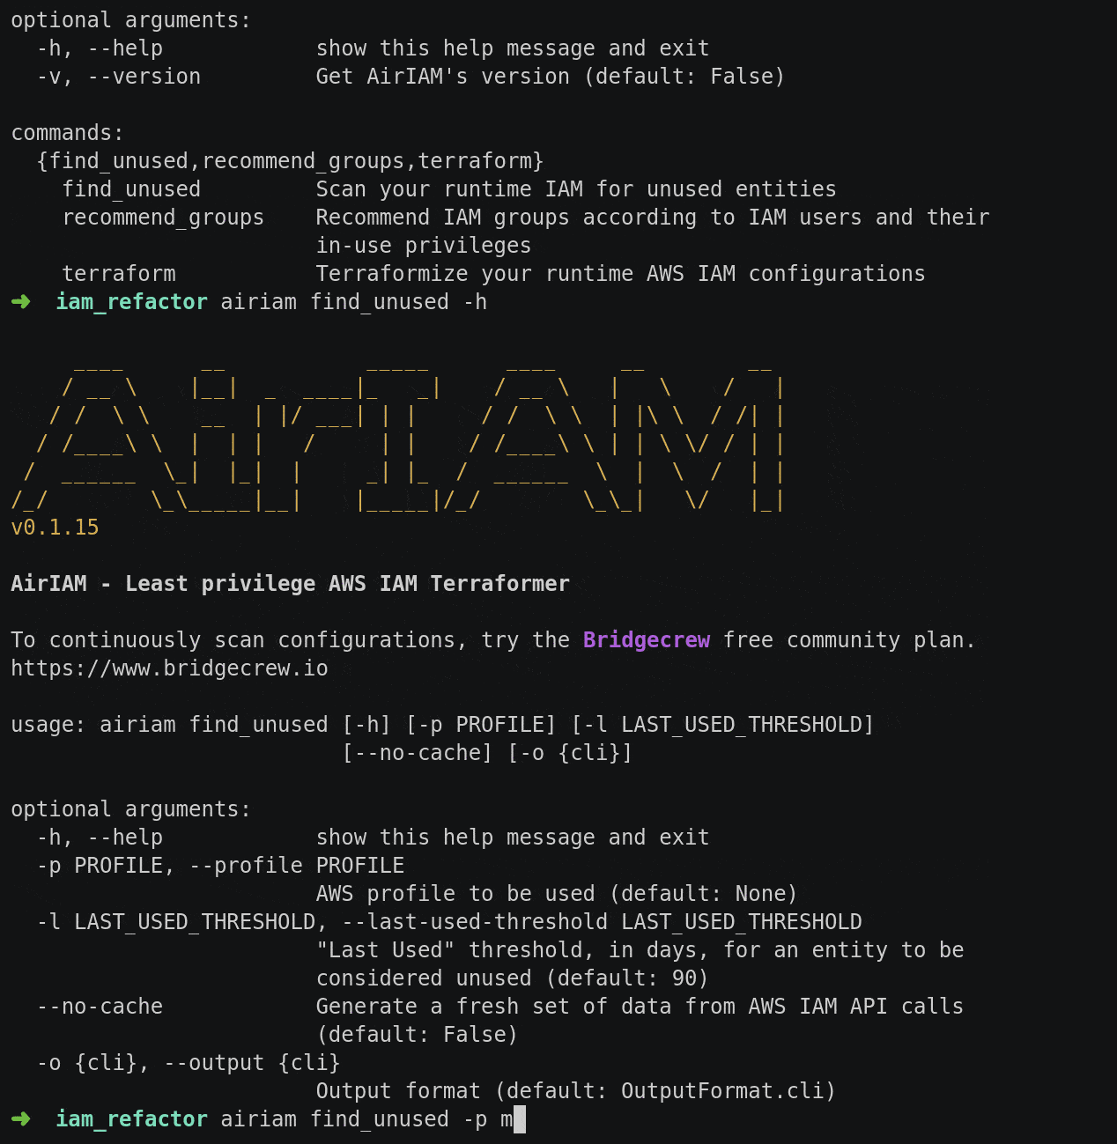
Least Privileged IAM
Identify over privileged accounts and create a least privileged IaC template
Reduce the attack surface and limit entitlements

Slide 25
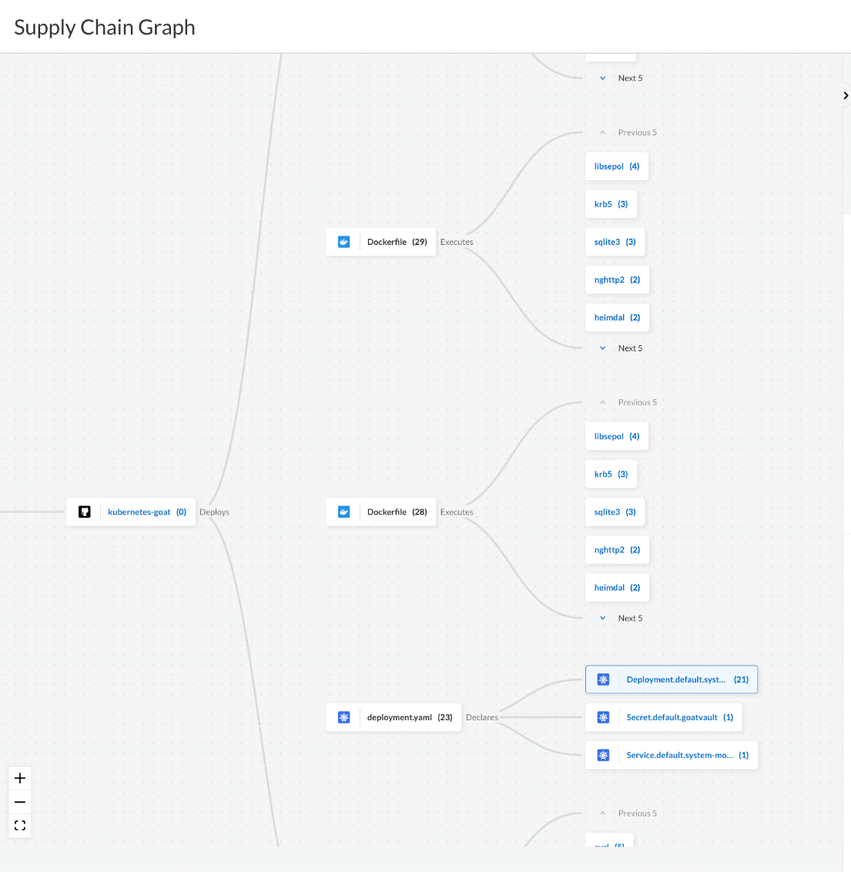
Software Supply Chain Security
Auto-discover code assets and model misconfigurations and vulnerabilities
Simple and complete inventory of key application and infrastructure asset dependencies to understand the attack surface
Vulnerable or misconfigured dependencies can be remediated using a single consolidated pull-request
Extends Checkov policy-as-code to harden VCS and CI/CD configurations

Slide 26
Integrations

Slide 27
Command Line Scanning
Scan container images and IaC templates from a local environment
Built to be extensible to be added to other DevOps tools
Build

Slide 28
IDE Integrations
Developers receive feedback as they code
Inline insights and quick fixes
Build

Slide 29
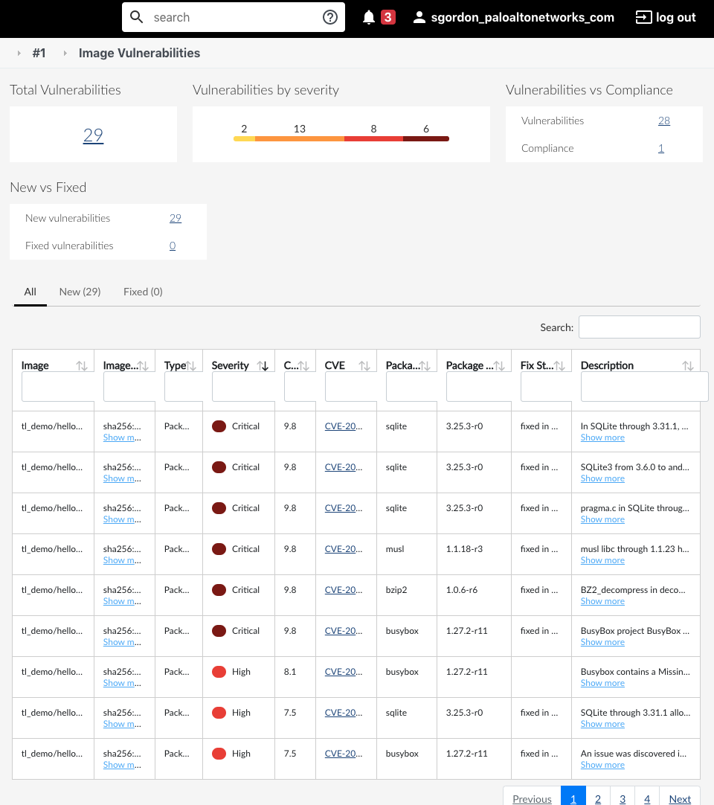
CI/CD Integrations
Native plugins and standalone scanner for integration into any CI/CD workflow or tool
Shift left quality gates with compliance and vulnerability thresholds in every build
Deploy
Automation Visibility Prevention

Slide 30
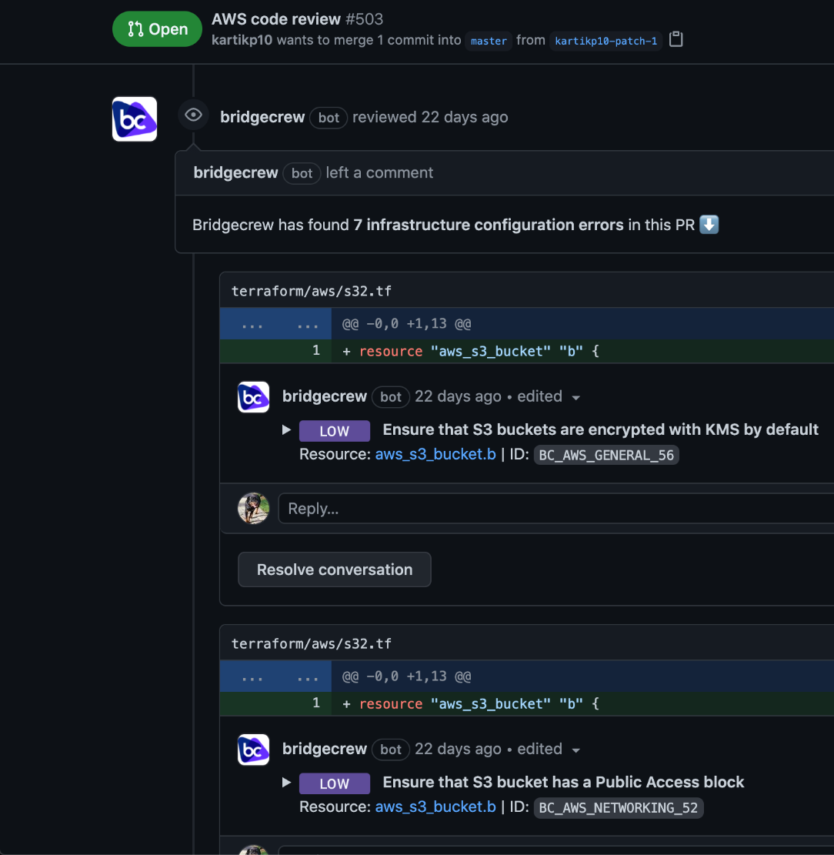
VCS Integrations
Automated scanning of repositories with pull request comments and commit ready automated fixes
Deploy
Automation Visibility Prevention

Slide 31
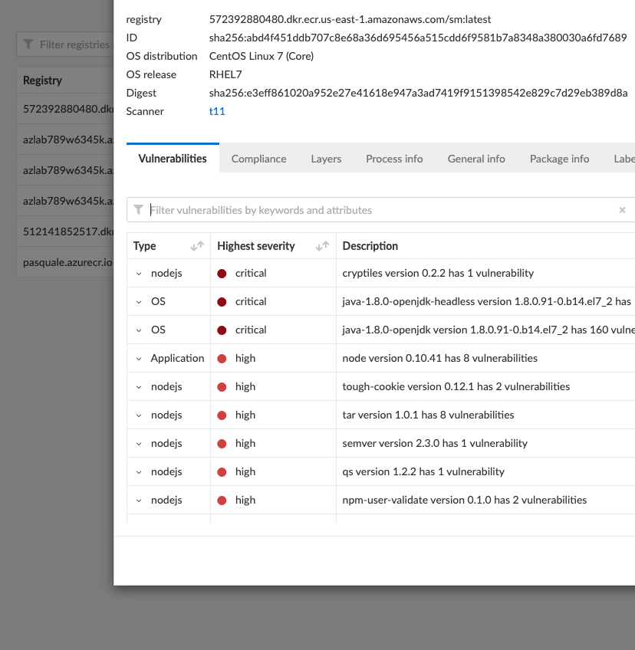
Registry Integrations
Continuously scan container images stored in popular container registries
Deploy
Automation Visibility Prevention

Slide 32
Centralized View
A single UI to view and control vulnerabilities and misconfigurations across integrations and scans
Run
Automation Visibility Prevention

Slide 33
Prisma Cloud
Cloud Native Security
Comprehensive
Full Lifecycle
For Any Cloud

Slide 35
Trends Driving DevOps Adoption
“By 2022, 25% of all software development projects will be following a DevOps methodology from conception to production, up from less than 10% in 2019.”
“Through 2022, 75% of DevOps initiatives will fail to meet expectations due to issues around organizational learning and change.”
Elite performers vs low performers:
973x more frequent deployments than low performers
6570x faster lead time to deploy
3x lower change failure rate
6570x faster time-to-recover from incidents when failure does happen
Hype Cycle for Cloud Security, 2021
State of DevOps, 2021
Notes:
There’s not doubt that DevOps has taken the industry by force. It’s all over every industry publication. And the benefits are massive, including faster innovation and more reliable applications. The problem is only a few companies reach that level of performance.

Slide 36
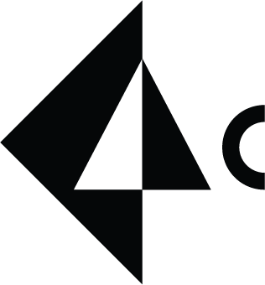
Most complete, full lifecycle protection
Consistent policies from build time to runtime
Developers love
CISOs trust
Cloud security embedded earlier in the dev lifecycle
+
Fewer compliance errors & faster time to remediation
Prisma Cloud
Reduced friction between security & developer teams
Notes:
The combination of Bridgecrew and Prisma Cloud completes our vision for full lifecycle cloud security posture management.
Misconfigurations are caught in build time and runtime for layered protection. Feedback is given in the preferred format for each team - developers in their DevOps tools and security teams in Prisma Cloud.
This creates feedback in context for developers and frees up under staffed security teams to use Prisma Cloud to catch misconfigurations that slip through and for our other powerful capabilities, like compliance reporting, threat detection and runtime protection.

Slide 37
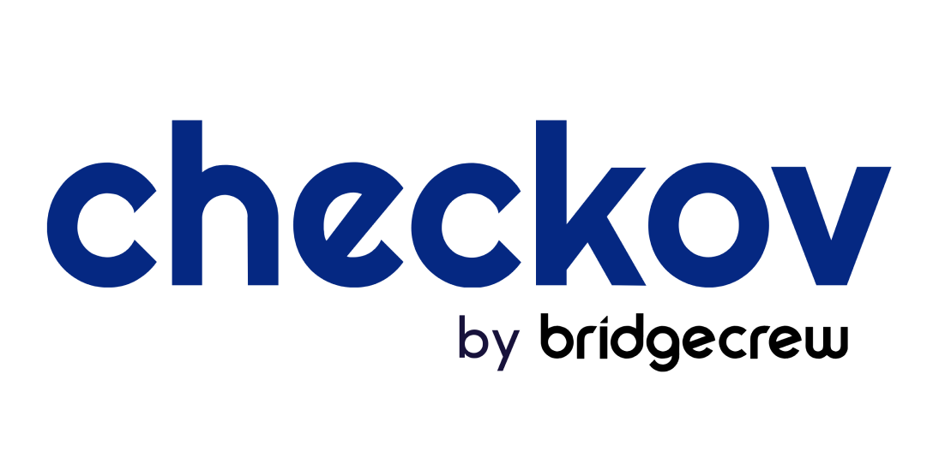
Checkov (open-source project) vs. Bridgecrew
IaC scanning | ✓ | ✓
Cloud and workload scanning | - | ✓
Security-as-code fixes | - | ✓
Smart Fixes | - | ✓
Runtime remediations | - | ✓
OOTB VCS integration | - | ✓
CI/CD integration | Requires customization | ✓
Notifications | Requires customization | ✓
Custom policies | Requires customization | ✓
Graph queries | ✓ | ✓
IaC scanning and policy-as-code engine ​
Supports Terraform, CloudFormation, Serverless, ARM templates, and more
Launched in December 2019​
700+ built-in infrastructure policies
Over 7.7M downloads​

Slide 38
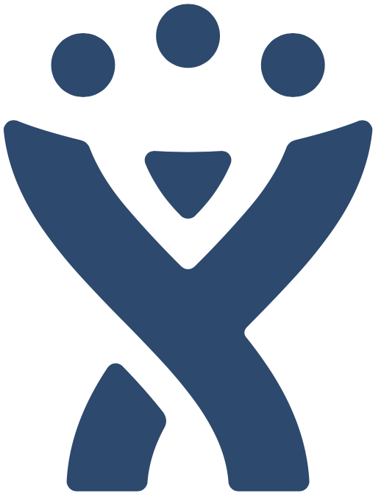
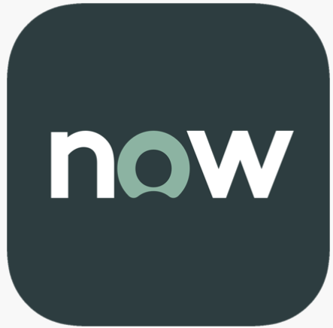
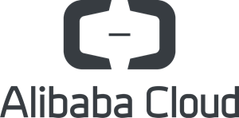
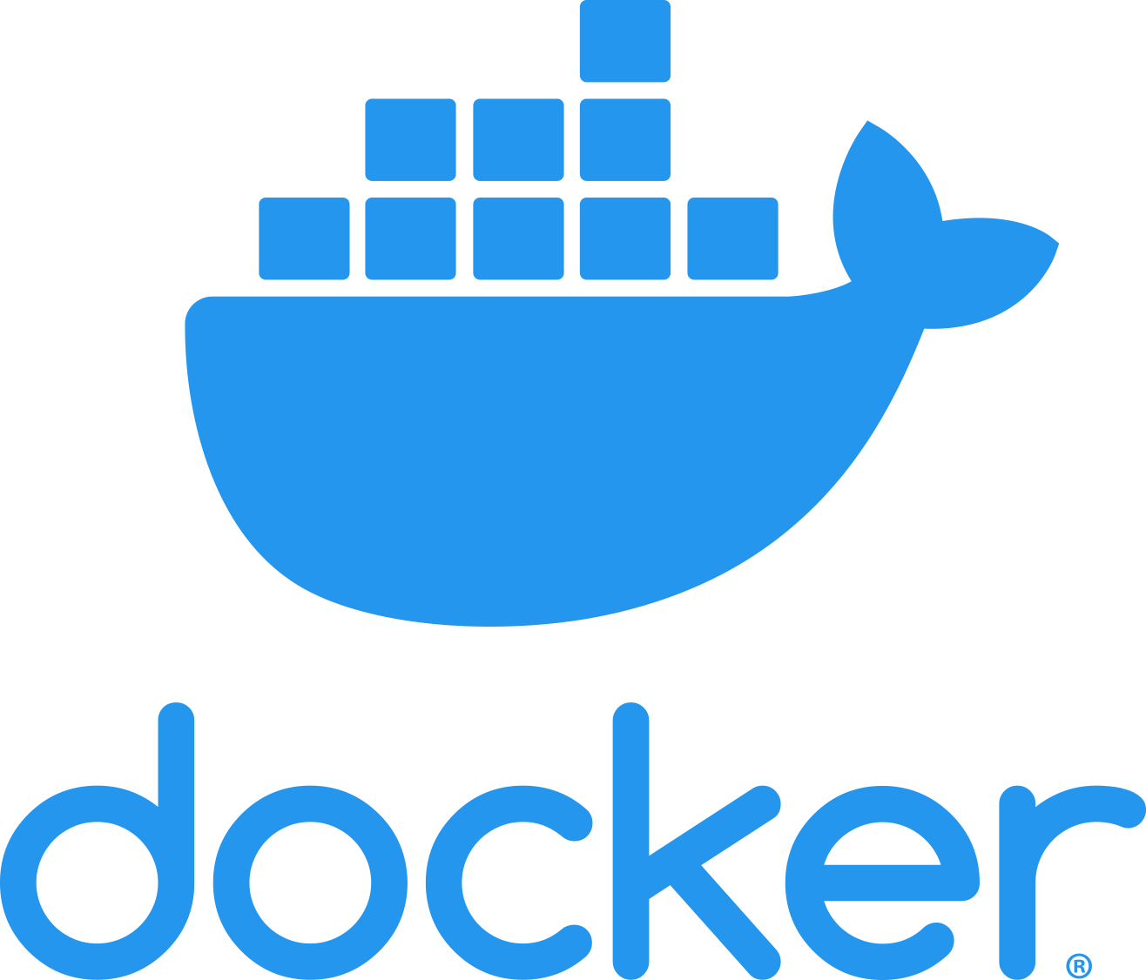
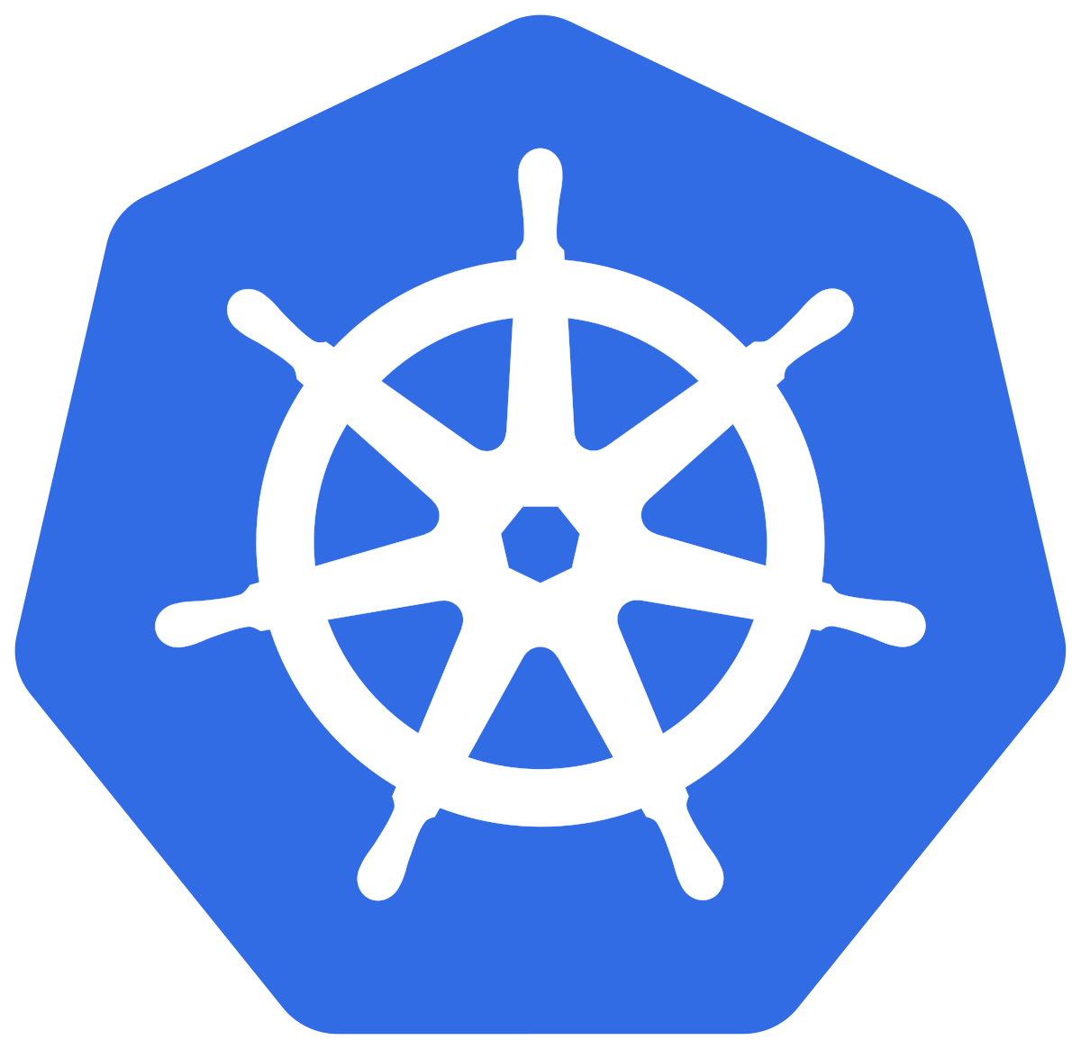
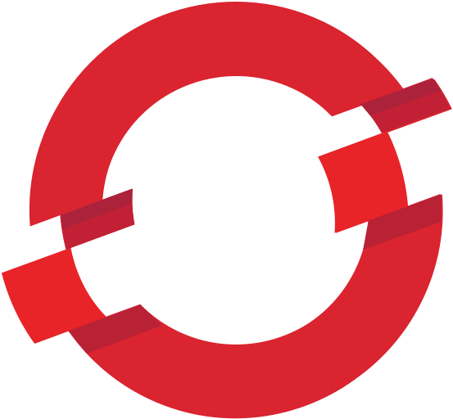
Coverage for the entire software pipeline
BUILD
DEPLOY
RUN
PRISMA CLOUD
Vulnerability and Infrastructure as Code (IaC) scanning integrated across IDE, SCM, and CI tools
Implement security checks into CD workflows and registries to prevent insecure deployments
Complete visibility and governance with total protection across the entire stack, anywhere

Slide 39
Security across the development lifecycle
BUILD
DEPLOY
RUN
CONTAINER AND VM IMAGE SCANNING
INFRASTRUCTURE AS CODE SCANNING
SECRETS SCANNING
VULNERABILITY MANAGEMENT
CONTINUOUS COMPLIANCE
NETWORK VISIBILITY
WEB APPLICATION & API SECURITY
ACCESS CONTROL

Slide 40
Three Options to Get Started
Open source policy-as-code
Developer-friendly automated security
Industry leading CNAPP
Notes:
If you want to get started with Cloud Code Security, there are a few options. You can start with visibility and policy-as-code using Checkov, or you can sign up for a 14-day trial of Bridgecrew, or you can jump to the full CNAPP capabilities of Prisma Cloud.

Slide 41
Full DevSecOps with bidirectional feedback
Available information, representative of running resources
8
4
Implement fixes into development lifecycle
Insights into all cloud resources and changes
5
1
Automatically remediate misconfigurations to secure state
Early VM and compliance feedback in IDE or CLI
6
2
Real time threat and user behavior protection
Collaborative guardrails with commits
3
7
Enforce policies automatically
Detect drift between code and cloud
Complexity, time, and risk of finding and fixing errors

